Slide 1
Underground @Twisted Element
May 6, 2023

Slide 2
What is the Chinook Fund?
The Calgary Chinook Fund was established in 2001 by a group of donors to assist funding groups involved in LGBTQIA2S+ issues, education, and support in the Calgary area.
In 2022 the formal name was changed to Chinook Fund for Gender and Sexual Diversity to better represent our community.

Slide 3
What does the Chinook Fund do?
Donors like you, help us raise money through events like tonight, and our annual fundraising dinner. The Calgary Foundation invests it for us, and the interest is paid out annually as grants.
All Chinook Fund Grants go to organizations that support and build the LGBTQIA2S+ community in Calgary.

Slide 4
Our endowment is approaching $1 million in value!

Slide 5
Chinook Fund Grants
$175,000+ in grants, so far, have been awarded to local organizations that support all segments of the LGBTQIA2S+ community in and around Calgary. Kids, youth, newcomers, elders, and the arts.
$35,000 of grants were awarded in 2022.

Slide 6
Some groups we helped
YOUth Riot

Slide 7
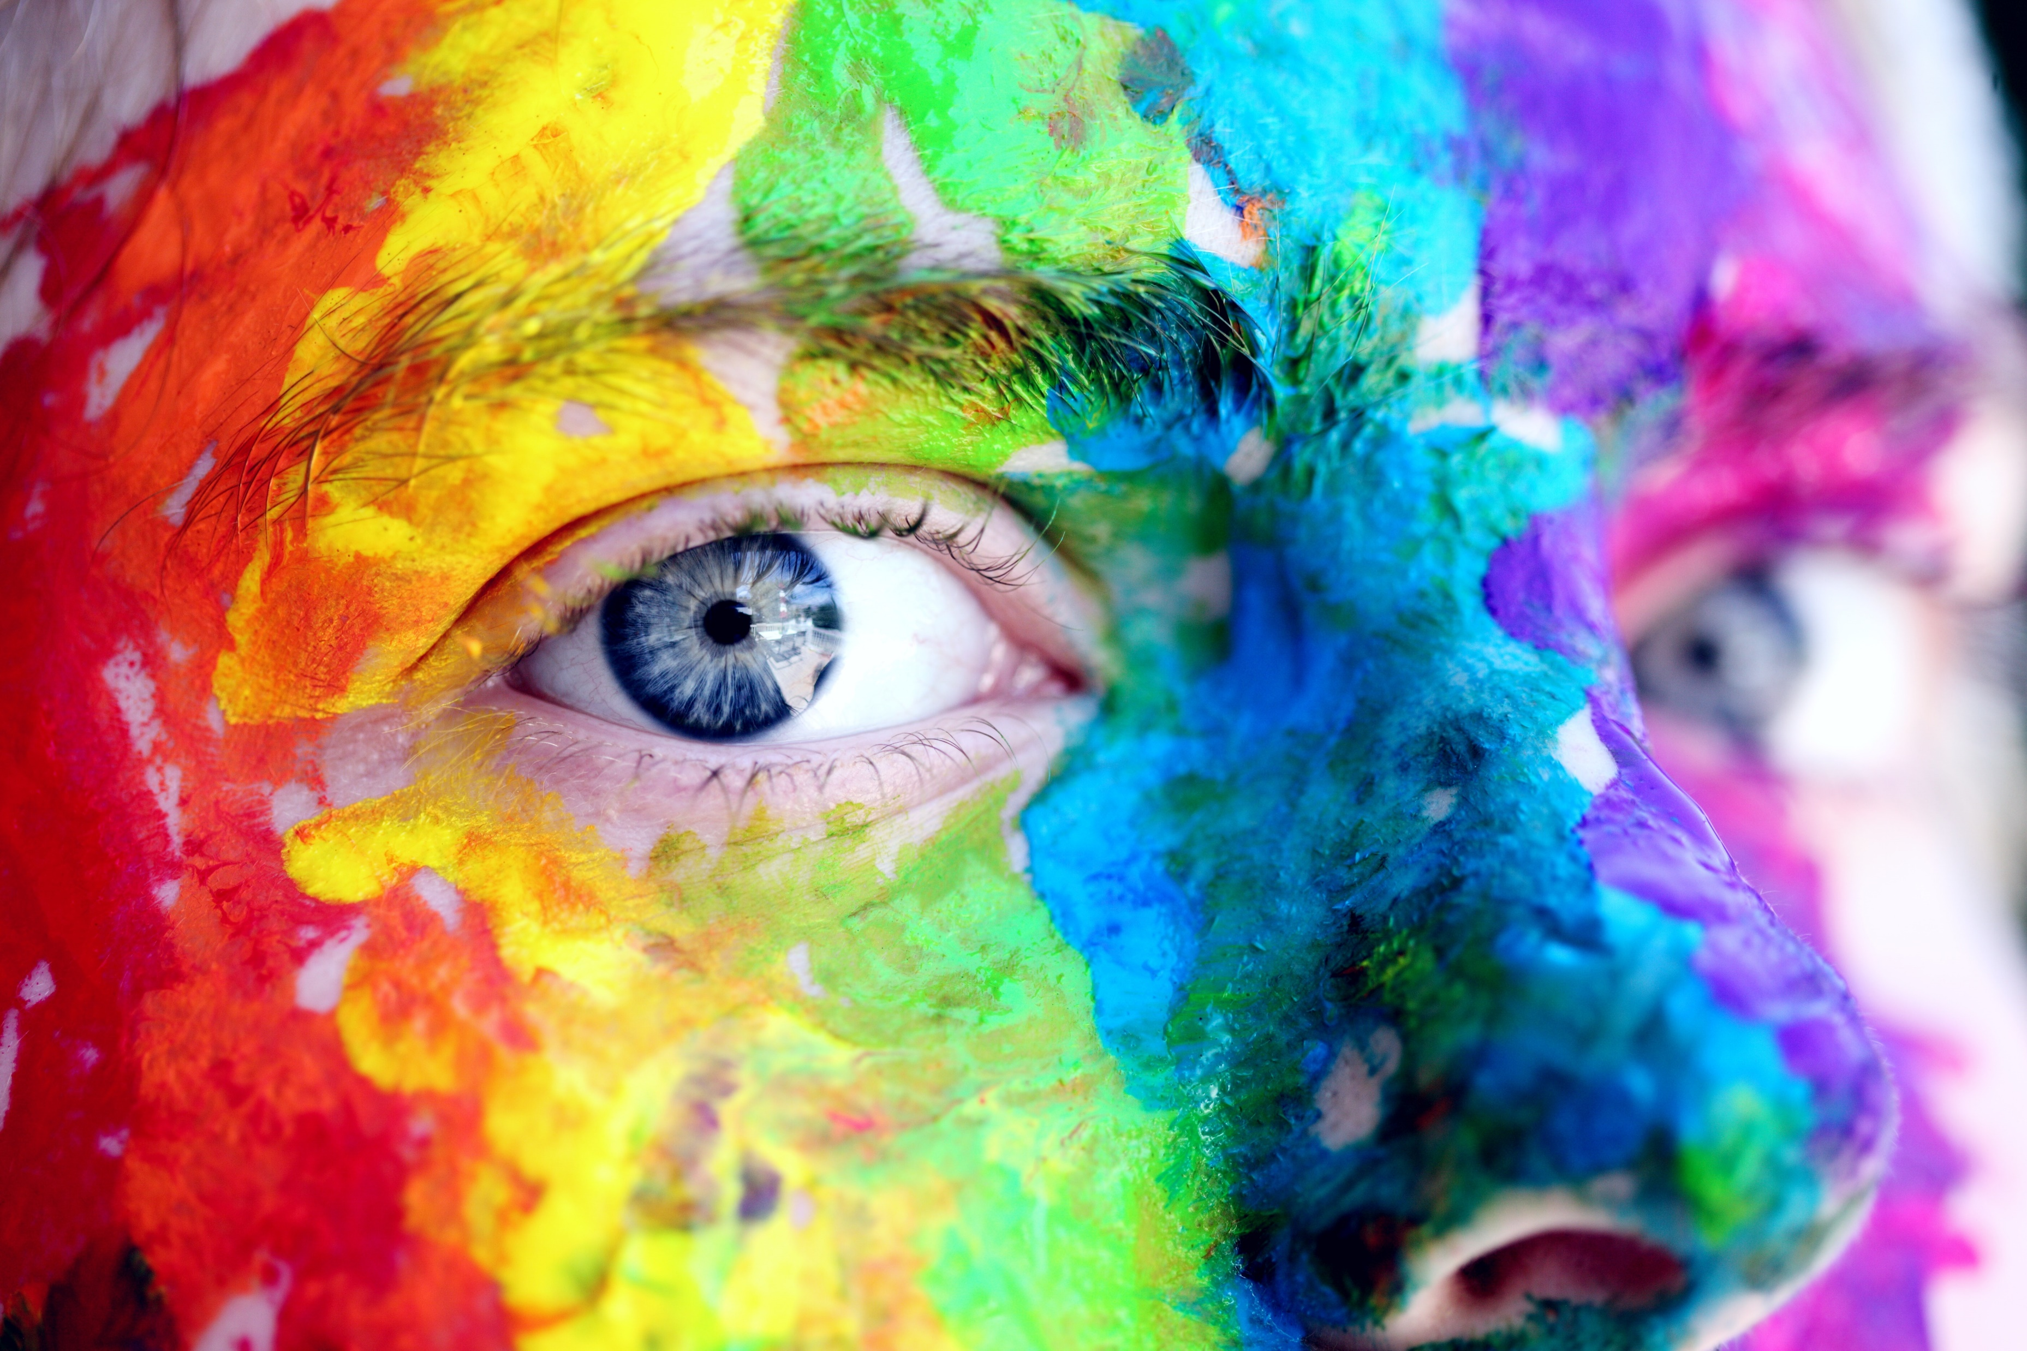
Chinook Fund Heroes
We give recognition annually to trailblazers who have made our world a better place.
The Chinook Fund Hero Award gives thanks and recognition to a person or group who has helped improve the LGBTQIA2S+ community.

Slide 8
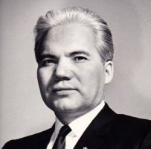
Bill Wuttunee 2019 Chinook Fund Hero
hey u up?
Not long-ago, gay sex was illegal.
Our 2019 Hero, Bill Wuttunee, an indigenous lawyer, fought that law.
As counsel for Everett Klippert, the last person in Canada prosecuted for homosexuality, Bill’s work led to the decriminalization of gay sex and helped establish our right to be queer.
Dangerous sexual offenders no more.

Slide 9
Imperial Sovereign Court of the Chinook Arch 2017 Chinook Fund Heroes
My Queen, My Hero
In 2017, we recognized Calgary’s Queens as heroes, the Imperial Sovereign Court of the Chinook Arch.
Calgary’s drag queens: ever present, ever fierce.

Slide 10
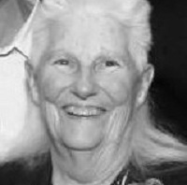
Lois Szabo 2015 Chinook Fund Hero
Hurricane Lois
Our 2015 Hero was Lois Szabo, the woman behind Calgary’s first gay bar, Club Carousel.
Opening a gay bar in 1970 was too risky a move for most… but not Hurricane Lois.

Slide 11
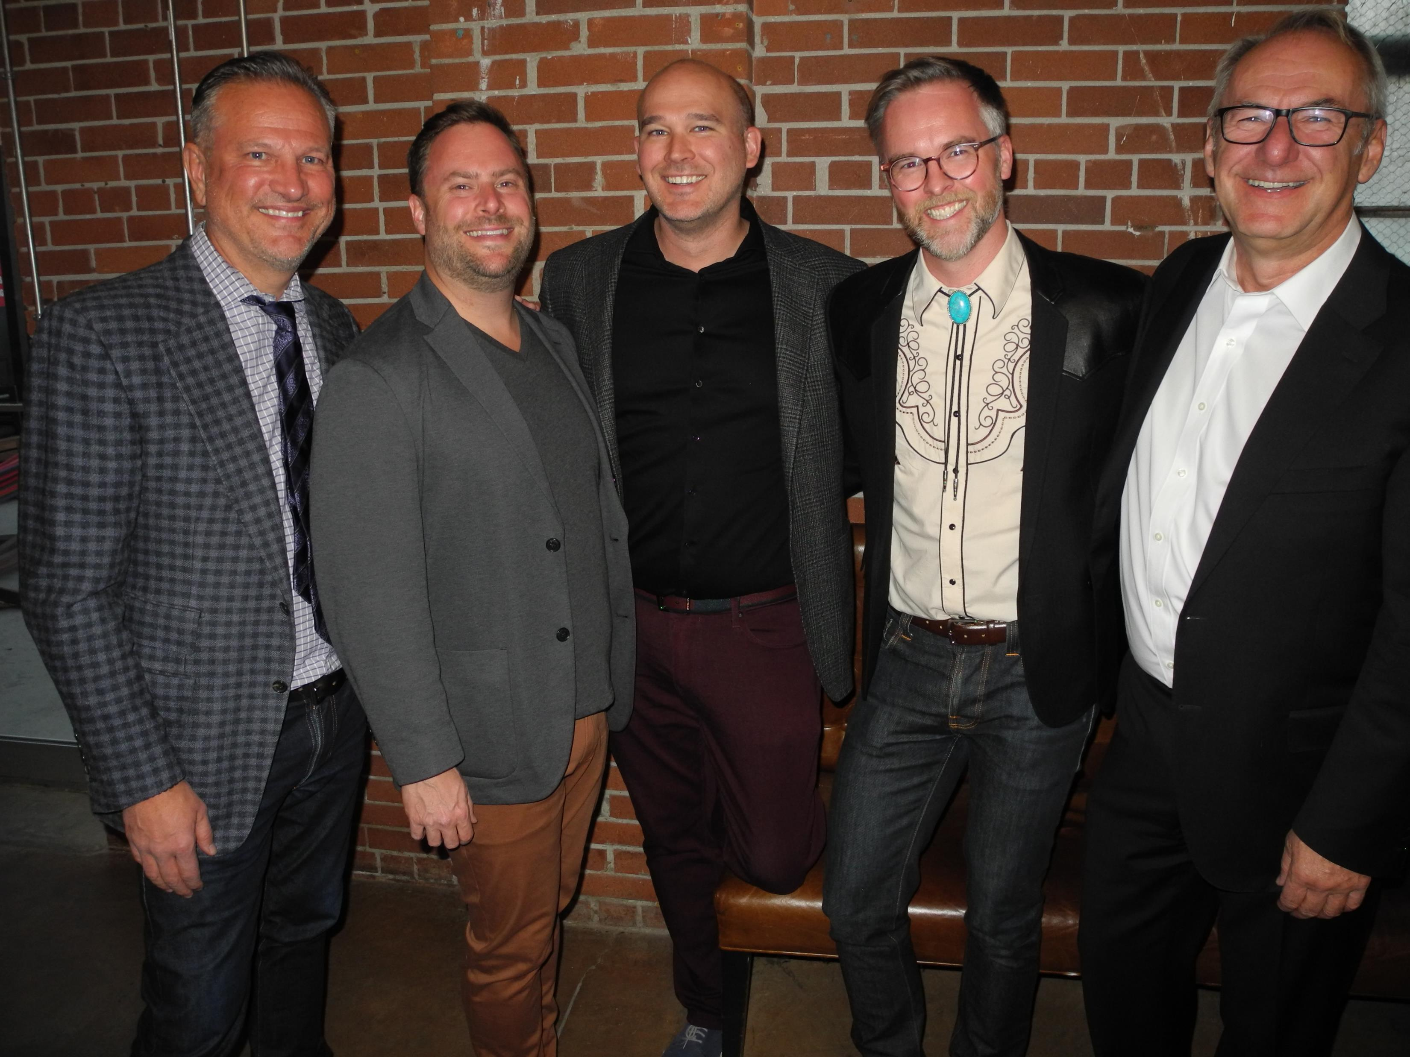
Chinook Fund Advisory Committee
Chris Post, Dave Emond, Bryan Clarke
Brian Clark, Gordon Sombrowski

Slide 12
Create your legacy!
Every dollar you give helps others.
100% of donations go in our endowment.
We have zero overhead. Everything done by volunteers.
Crowdsourcing donations packs a punch.
By combining your gift with others’, we can pay out big grants.

Slide 13
Create your legacy!
Create your personal legacy with the Chinook Fund
Donations to the Chinook Fund literally give back forever. Here’s how:
All donations go into our endowment.
The endowment is invested.
Only investment income is paid out in grants.
Your donation stays in the endowment…and keeps on giving…over and over…forever and ever….

Slide 14
Underground @Twisted Element
Help us, help others!
calgarychinookfund.ca
→Donate
→DonateOnlineNow

